Slide 1
Harbin Institute of Technology
Series-Parallel Reconfigurable Supernumerary Robotic Limbs
警用机器人现状分析
Yanhe Zhu

Slide 2
CONTENTS
1
Introduction
2
Design of SP-Limbs
3
Related Works

Slide 3
Curriculum Vitae
Yanhe Zhu
Professor of Mechanical Engineering
Vice Director of State Key Laboratory of Robotics and System
Harbin Institute of Technology
yhzhu@hit.edu.cn
Education：
Ph.D Mechanical Engineering Harbin Institute of Technology 2004 S.M. Mechanical Engineering Harbin Institute of Technology 2000
B.S. Mechanical Engineering Harbin Institute of Technology 1998
Selected Professional Service：
Advisory Board, National Key R&D Program； 2018
Chair, Organizational Committee of China Robot Academic 2018
Annual Conference;
Advisory Board, Theme Argumentation Group of Innovation 2017
Special Zone of Science and Technology Committee；
Advisory Board, National Natural Science Foundation of China ； 2016
Honors and Awards：
Gold Award, China Excellent Industrial Design (CEID) 2018
Best Paper Award, International Conference on BIC-TA 2017
Four Provincial or Ministerial Awards； 2014-2018

Slide 4
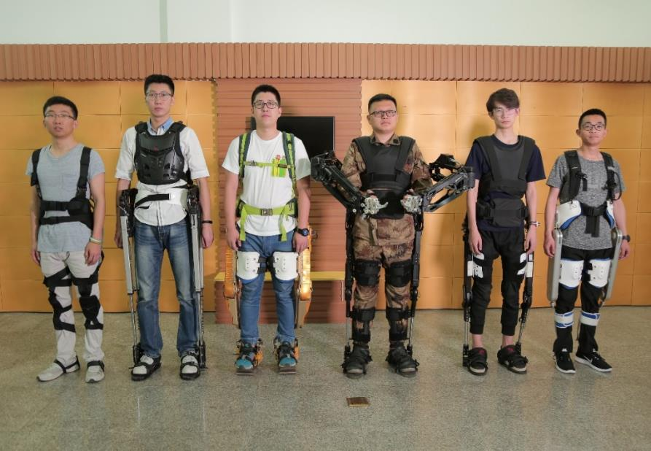
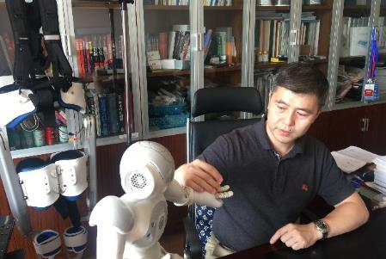
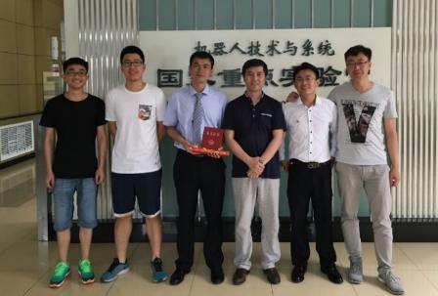
Laboratory
National Center for Robotics Innovation
State Key Laboratory of Robotics and System

Slide 5
CONTENTS
1
Introduction
2
Design of SP-Limbs
3
Related Works

Slide 6
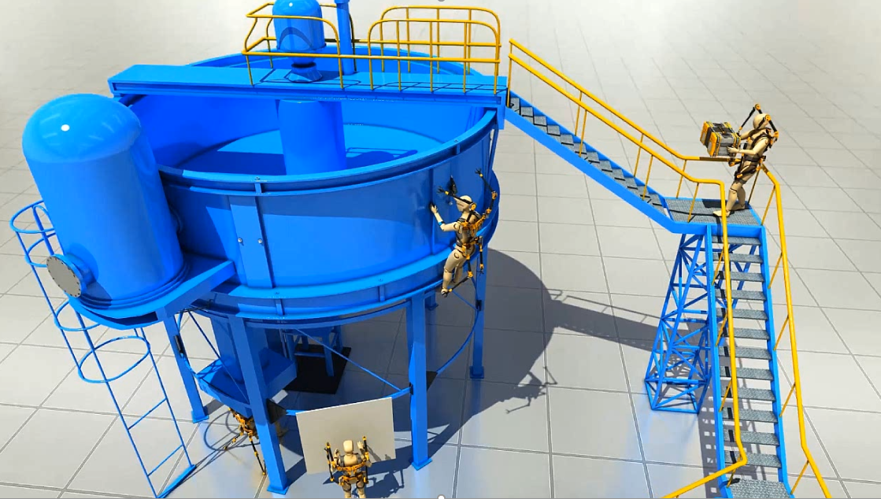
Concept Display

Slide 7
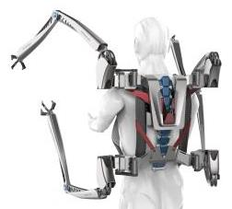
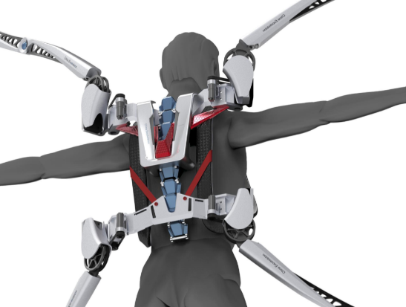
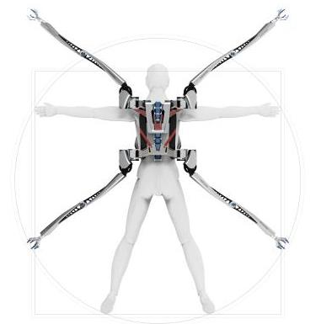
SP-Limbs concept
Four extra robotic limbs;
No obstructions on human upper limb movement;
Greatly expand human abilities;
Easy to take on and off;

Slide 8
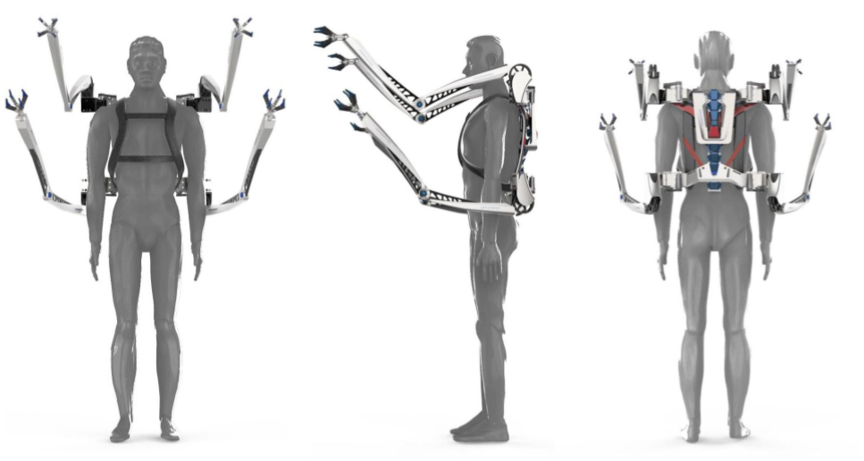
HIT-SRL concept
Front
Side
Back

Slide 9
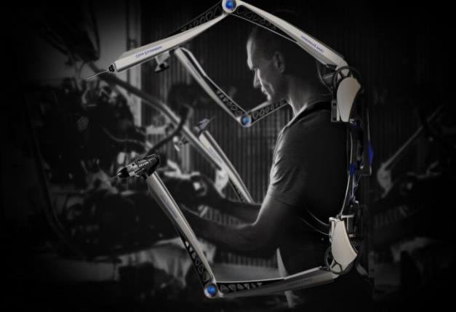
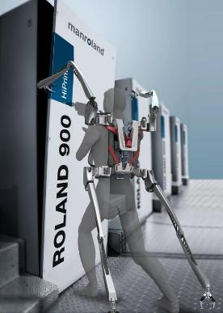
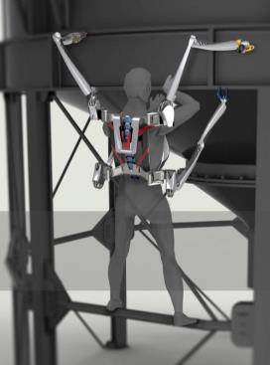
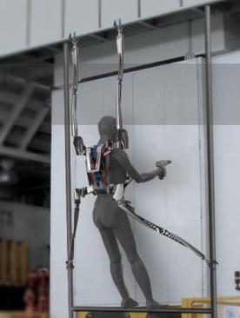
HIT-SRL concept
Help people hold heavy thing overhead
Support human weight
Protect people who work off the ground

Slide 10
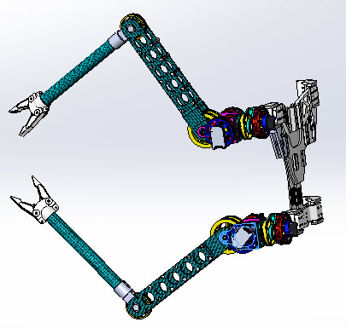
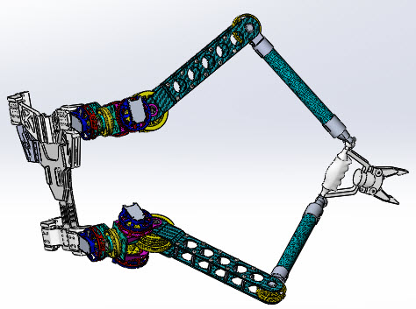
Mechanical Design
Series
Parallel
z
z
x
x
y
y
Mode | Series | Parallel
DOF | 3 | 6
Merits | Large working space | Large force
 | Agile motion | High stiffness
Application | Grasping operation | Load operation
 | Support operation | Delicate operatio

Slide 11
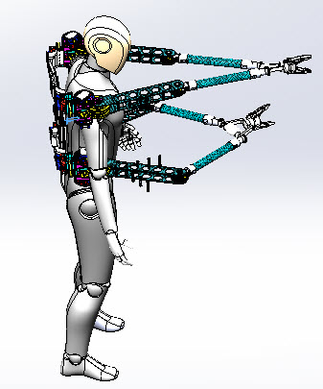
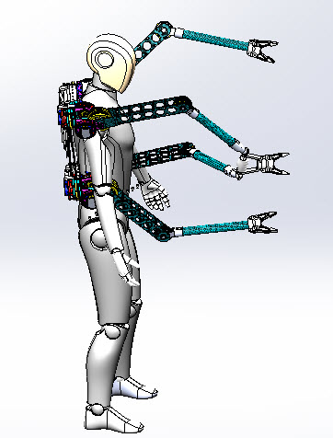
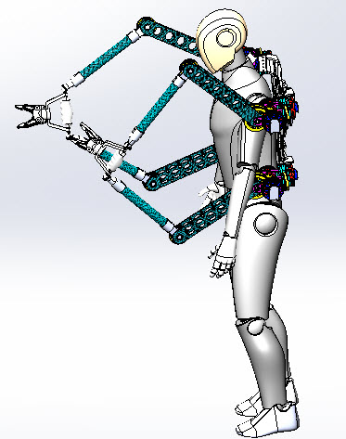
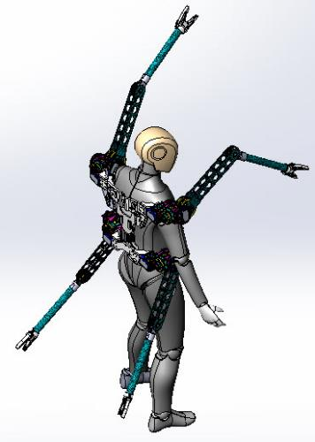
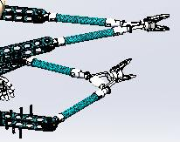
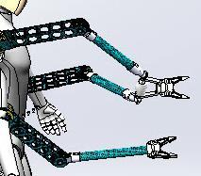
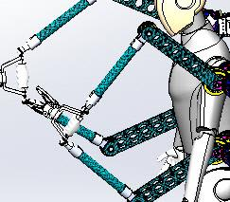
Multi-Configuration Model
Series mode
Configuration 1
Configuration 2
Configuration 3
Parallel mode

Slide 12
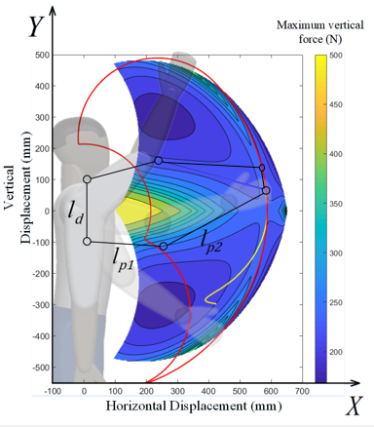
Comparison of Motion Space
（a） Series mode
（b）Parallel mode
The parallel mode has better supporting performance in the region of the distal boundary of the motion space

Slide 13
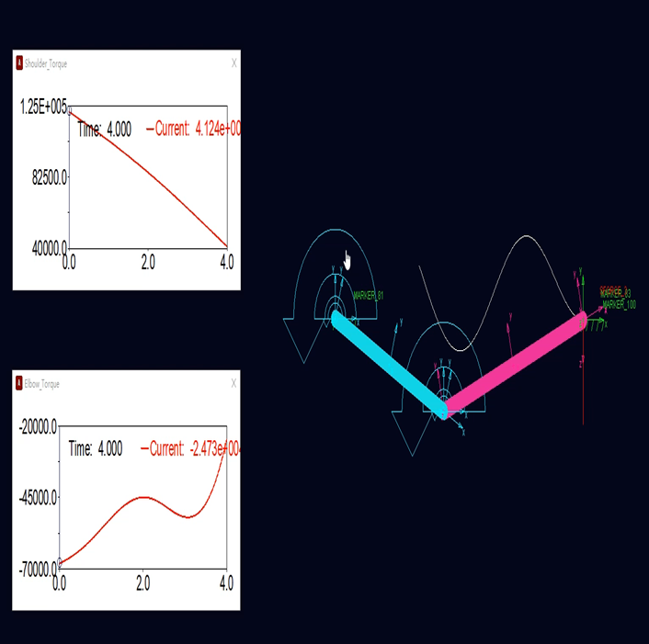
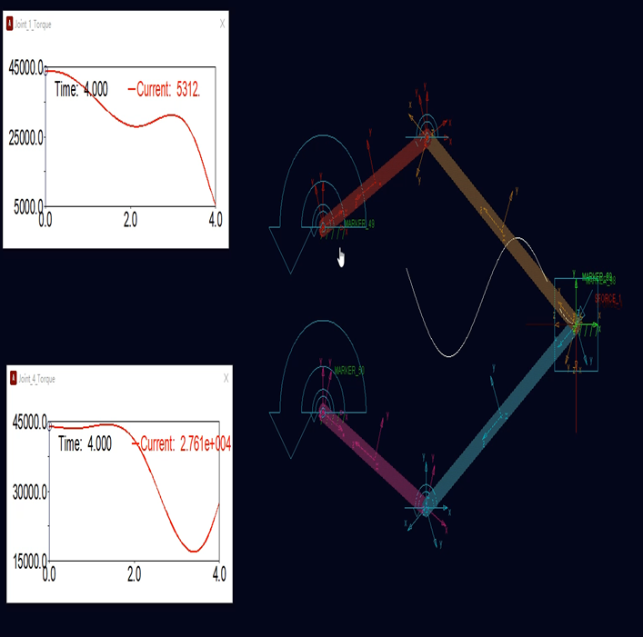
Comparison of Joint Torque
Series mode
Parallel mode
Parallel mode has good output performance.

Slide 14
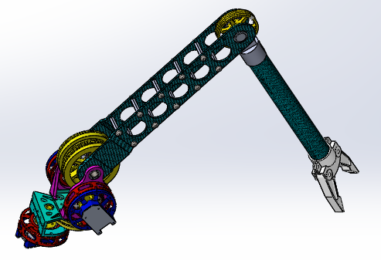
The Robotic Limb Design
Weight | Maximum load | Load to weight ratio
3.6kg | 120N | 3.3:1
Parallel Coupling Drive
End effector
Motor
Wire Drive

Slide 15
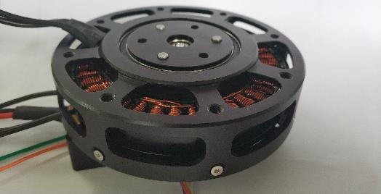
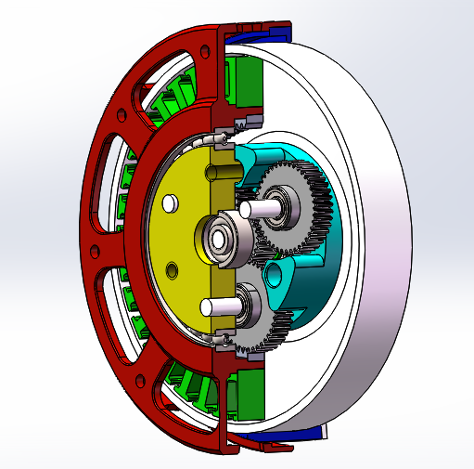
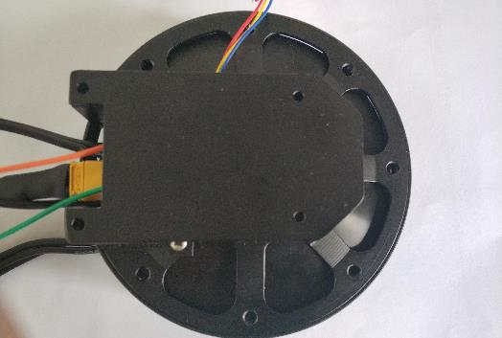
The Motor Module Design
Inspired from MIT
Based on a disc motor and the 6:1 planetary gear
Rotor
Tie
Planetary gear
Sun gear
Weight | Overall dimension | Maximum Output Torque
470 g | Φ 96 ×40 mm | 18Nm

Slide 16
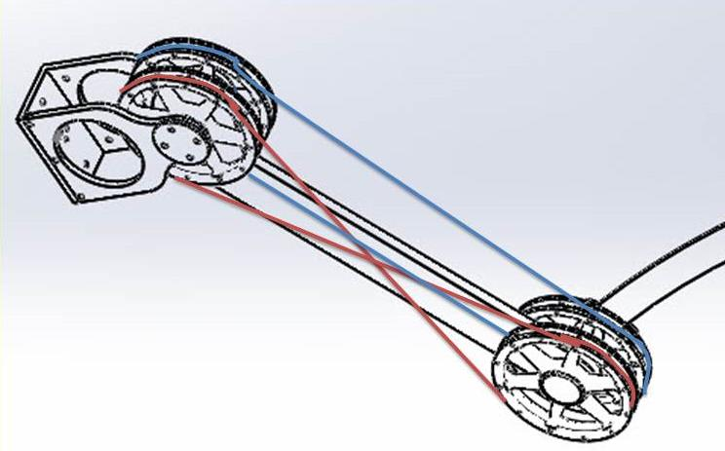
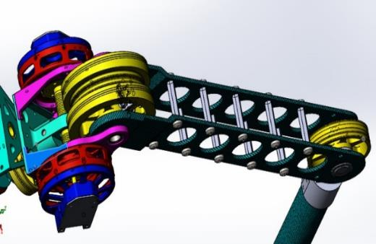
Principle of Parallel Coupling Drive
Shoulder Joint
Wire Pulley 1
Wire Pulley 3
Forearm
Wire Pulley 2
Wire Pulley 4
Elbow Joint

Slide 17
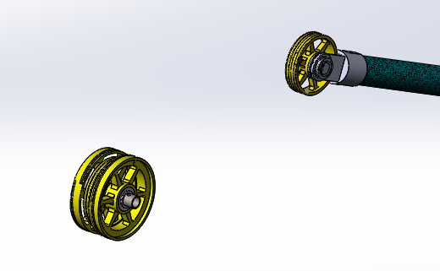
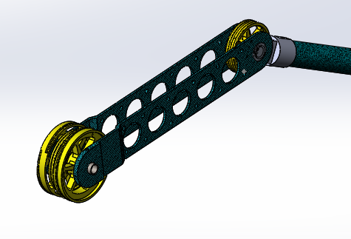
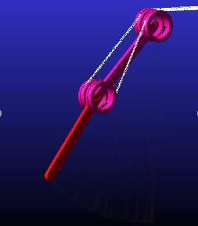
Force Analysis of Parallel Coupling Drive
Drive in the same direction with same torque
The Upper arm rotates, the forearm keeps still
Drive in the opposite direction with same torque
The Upper arm keeps still, the forearm rotates

Slide 18
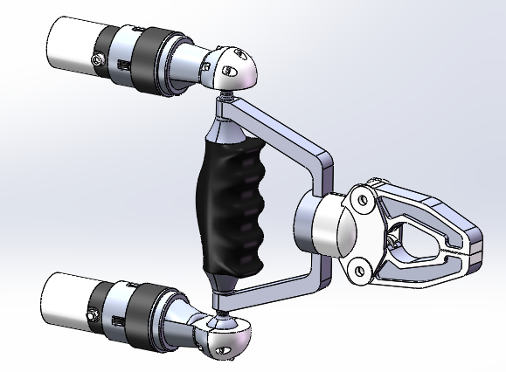
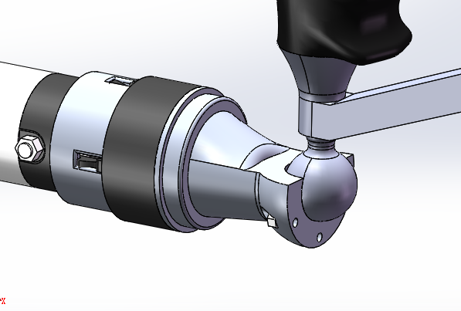
End effector Design
Two robotic arms are connected by the ball hinge to realize 6 DOF of the end.
The rotational degree of freedom is manual implemented by the operator

Slide 19
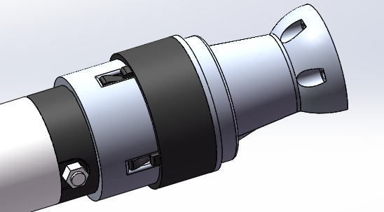
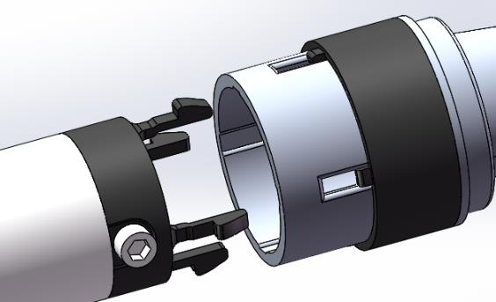
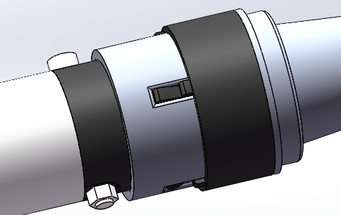
End effector Design
19
Installation buckle
Snap-in type
Easy and quick installation
Disassembly buckle
Installation
Disassembly

Slide 20
CONTENTS
1
Introduction
2
Design of SP-Limbs
3
Related Works

Slide 21
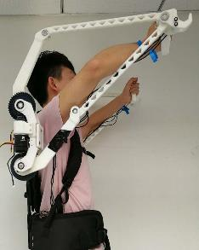
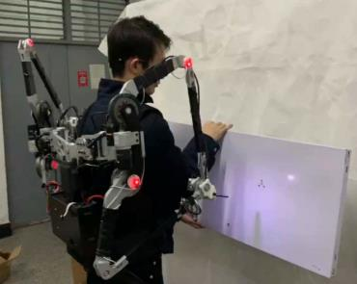
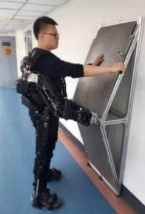
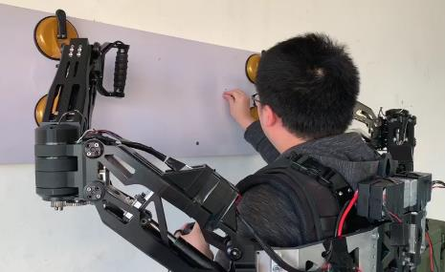
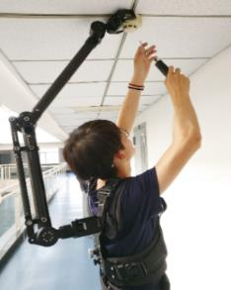
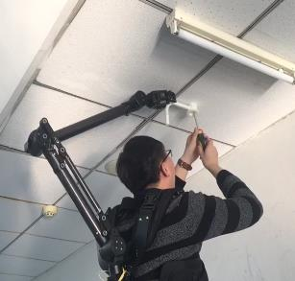
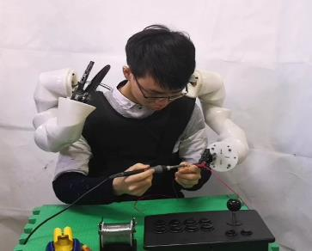
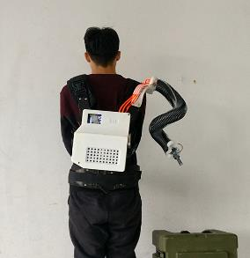
Related Works
The parallel, series, modular and soft supernumerary limb robots have been developed independently.
1
Delicate operation
2
Load operation
3
Support operation
4
Aided operation
5
Smooth operation

Slide 22
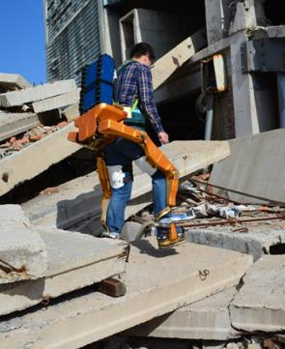
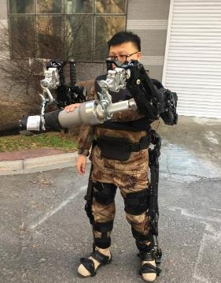
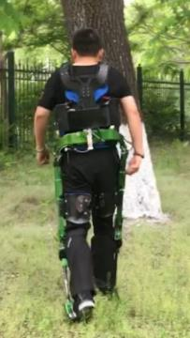
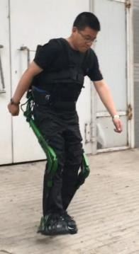
Related Works
22
We have independently developed various wearable exoskeleton robots for emergency rescue, industrial manufacture，outdoor activities and rehabilitation.
Emergency rescue
Outdoor activities
Industrial manufacture
Rehabilitation

Slide 23
Thanks
Notes:
汇报到此结束，谢谢各位专家。

